Slide 1
Machine Learning
Introduction

Slide 2
Grading
Seminar participation 5%
5 Programming assignments – 25%
Late submission will be penalized 20% per late day. However, no assignment will be accepted more than three days after its due date.
Midterm exam- 25%
Project – 15%
Final exam – 30%
Extra 5%: attending all scheduled classes on time
Office Hour: 10:00-11:15am on Wednesday in 318B
Prerequisites: | Students entering the class are expected to have a knowledge of probability and statistics, calculus, linear algebra, algorithm theory and programming

Slide 3
Topics
Introduction
Linear Regression
Logistic Regression
Regularization
Artificial Neural Networks
Advice for Applying Machine Learning
Machine Learning System Design
Support Vector Machines
Unsupervised Learning
K-means algorithm
Dimensionality Reduction
Anomaly Detection
Recommender Systems
Large Scale Machine Learning
Deep learning
Convolutional Neural Networks
Recurrent Neural Networks

Slide 4
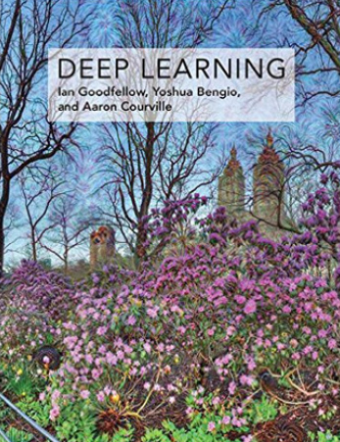
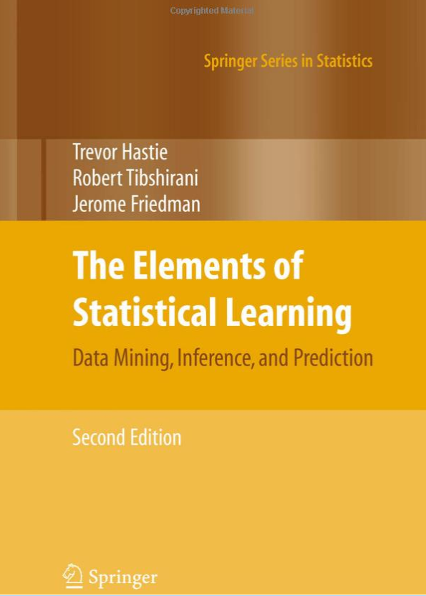
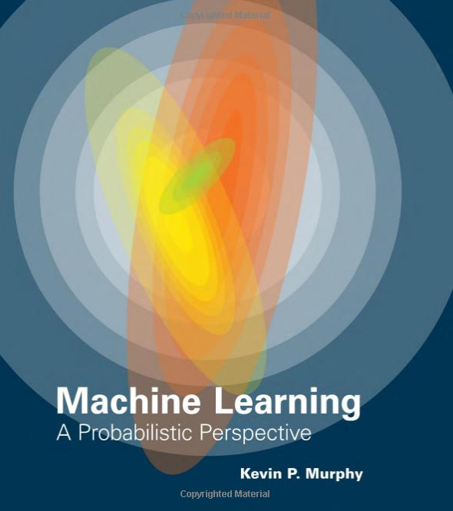
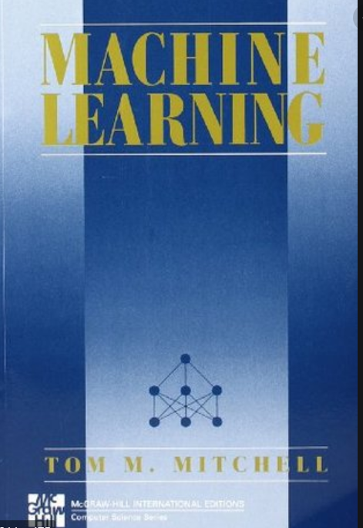
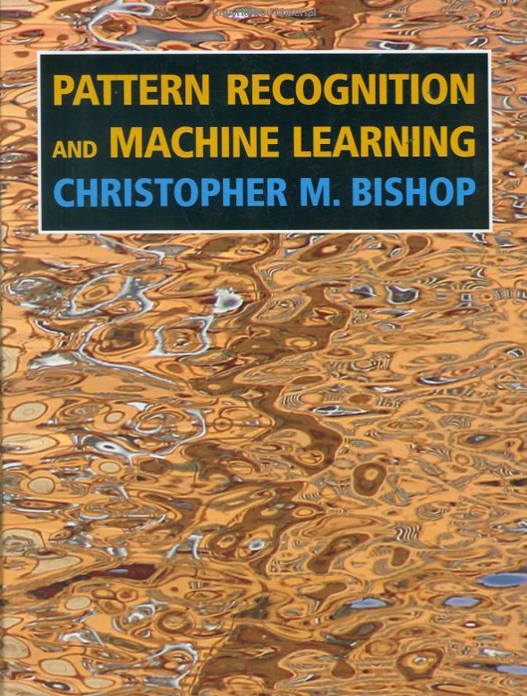
Textbooks
Andrew Ng. Machine Learning Notes. 2019. Stanford University.
http://cs229.stanford.edu/notes2019fall/
Supplementary materials
Ian Goodfellow, Yoshua Bengio, Aaron Courville. Deep Learning. 2016
Kevin P. Murphy. Machine Learning: A Probabilistic Perspective. 2012
Trevor Hastie, Robert Tibshirani, Jerome Friedman. The Elements of Statistical Learning: Data Mining, Inference, and Prediction, Second Edition (2nd Edition). 2016.
Bishop C, Pattern Recognition and Machine Learning, 2007
Mitchell T, Machine Learning, McGraw-Hill, 1997

Slide 5
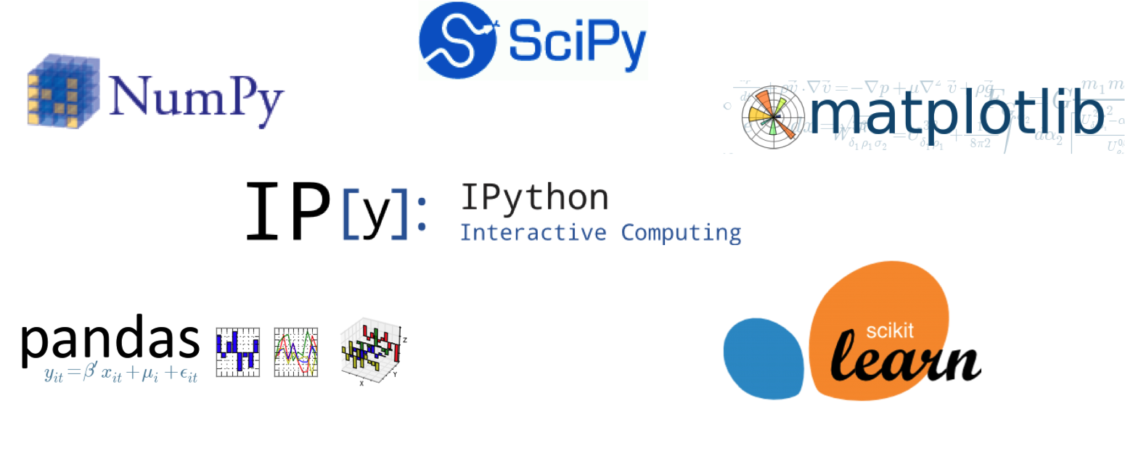
Machine Learning Libraries

Slide 6
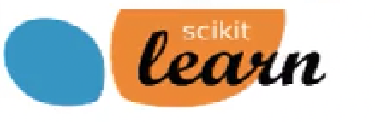
Scikit learn: Python Machine Learning Library
Scikit-learn Homepage http://scikit-learn.org
Scikit-learn User Guide http://scikit-learn.org/stable/user_guide.html
Scikit-learn API reference http://scikit-learn.org/stable/modules/classes.html
In Python, we typically import classes and functions we need like this:
from sklearn.model_selection import train_test_split
from sklearn.tree import DecisionTreeClassifier

Slide 7
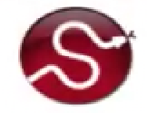
SciPy Library: Scientific Computing Tools
Provides a variety of useful scientific computing tools, including statistical distirbutions, optimization of functions, linear algerba, and a variety of specialized mathematical functions.
With scikit-learn, it provides support for sparse matrices, a way to store large tables that consist mostly of zeros.
Example import: import scipy as sp
http://www.scipy.org/

Slide 8
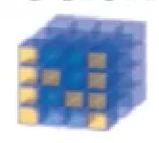
NumPy: Scientific Computing Library
http://www.numpy.org/
Provides fundamental multi-dimensional arrays.
Typically, data that is input to scikit-learn will be in the form of a NumPy array.
Example impport: import numpy as np

Slide 9
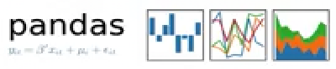
Pandas: Data Manipulation and Analysis
http://pandas.pydata.org/
Provides key data structures like DataFrame
Also, support for reading/writing data in different formats
Example import: import pandas as pd

Slide 10
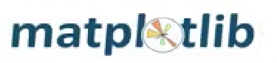
Matplotlib and other plotting libraries
http://matplotlib.org/
We typically use matplotlib’s pyplot module: import matplotlib.pyplot as plt
We also sometimes use the seaborn visualization library (http://seaborn.pydata.org/)
import seaborn as sn
And sometimes the graphviz plotting library: import graphviz

Slide 11








Machine Learning (Online courses)
via Coursera
via Coursera
via Udacity
via edX
via edX
via Coursera
via Coursera
via Udacity

Slide 12
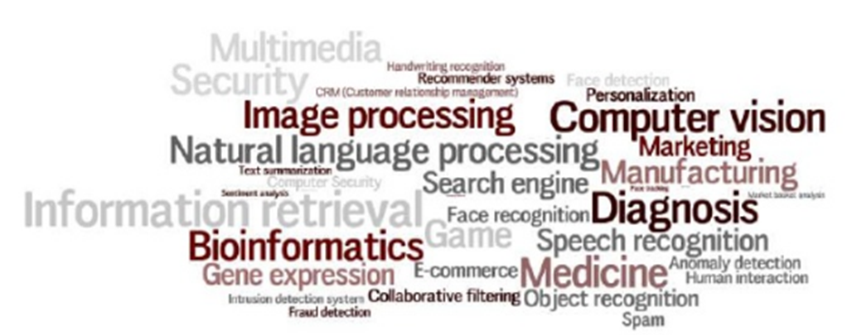
ML Applications

Slide 14
A Few Quotes
“A breakthrough in machine learning would be worth ten Microsofts”
(Bill Gates, Chairman, Microsoft)
“Machine learning is the next Internet” (Tony Tether, Director, DARPA)
Machine learning is the hot new thing” (John Hennessy, President, Stanford)
“Web rankings today are mostly a matter of machine learning”
(Prabhakar Raghavan, Dir. Research, Yahoo)
“Machine learning is going to result in a real revolution”
(Greg Papadopoulos, Former CTO, Sun)
“Machine learning is today’s discontinuity” (Jerry Yang, Founder, Yahoo)
“Machine learning today is one of the hottest aspects of computer science”
(Steve Ballmer, CEO, Microsoft)

Slide 15
Definition of AI
“Intelligence: The ability to learn and solve problems”
Webster’s Dictionary.
“Artificial intelligence (AI) is the intelligence exhibited by machines or software’
Wikipedia
“The science and engineering of making intelligent machines”
McCarthy.
“The study and design of intelligent agents, where an intelligent agent is a system that perceives its environment and takes actions that maximize its chances of success.”
Russel and Norvig AI book.
“Just as the Industrial Revolution freed up a lot of humanity from physical drudgery, I think AI has the potential to free up humanity from a lot of the mental drudgery.”
Andrew Ng

Slide 16
What is AI?
Four schools of thoughts (Russel & Norvig)
Thinking humanly | Thinking rationally
“The exciting new effort to make | “The study of mental faculties
computers think... machines with | through the use of computational
minds, in the full and literal sense.” | models.” (Charniak and McDermott,
(Haugeland, 1985) | 1985
Acting humanly | Acting rationally (Our approach)
“The study of how to make com- | “Computational Intelligence is the
puters do things which, at the mo- | study of the design of intelligent
ment, people are better.” (Rich and | agents.” (Poole et al., 1998)
Knight, 1991)

Slide 17

https://www.prowesscorp.com/whats-the-difference-between-artificial-intelligence-ai-machine-learning-and-deep-learning/

Slide 18
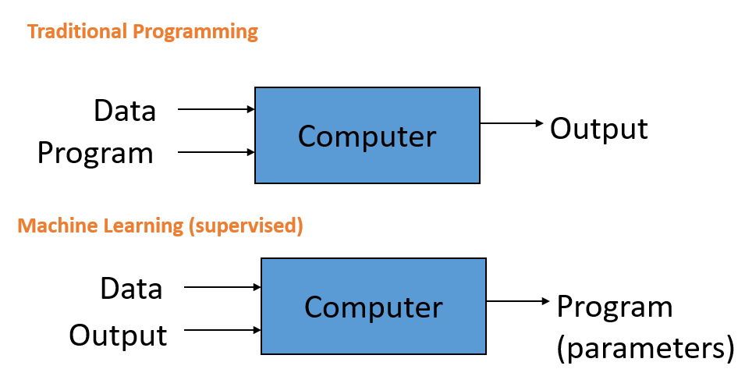
Machine Learning definition
Arthur Samuel (1959). Machine Learning: Field of study that gives computers the ability to learn without being explicitly programmed.

Slide 19
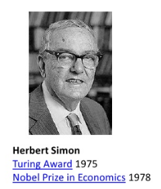
Machine Learning definition
Herbert Simon.
Learning is any process by which a system improves performance from experience.
Machine Learning is concerned with computer
programs that automatically improve their
performance through experience.

Slide 20
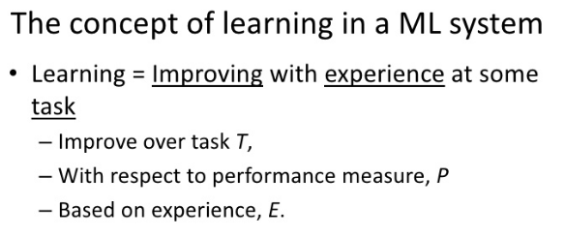
Machine Learning definition
Tom Mitchell (1998). A computer program is said to learn from experience E with respect to some task T and some performance measure P, if its performance on T, as measured by P, improves with experience E.

Slide 21
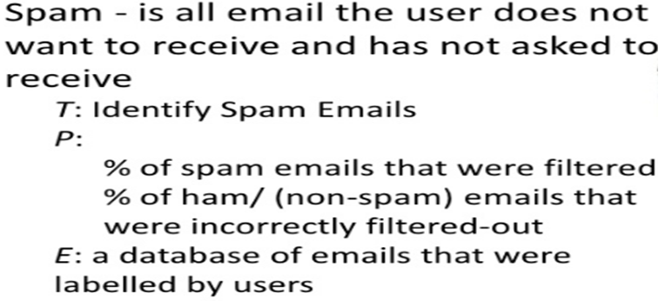
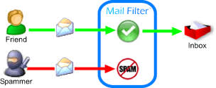
Example: Spam Filtering

Slide 22
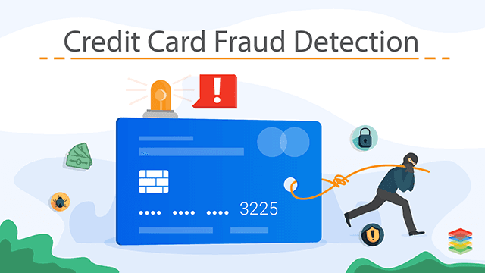
Question. Learning to detect credit card fraud. What are T, P and E?
Task T: Assign label of fraud or not fraud to credit card transaction
Performance measure P: Accuracy of fraud classifier
Training experience E: Historical credit card transactions labeled as fraud or not

Slide 23
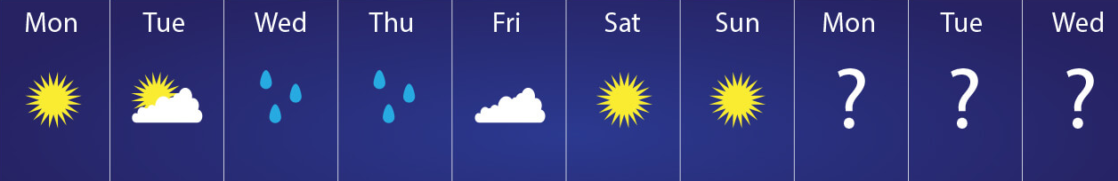
Question.
Suppose we feed a learning algorithm a lot of historical weather data, and have it learn to predict weather. What are E, P and T?

Slide 24
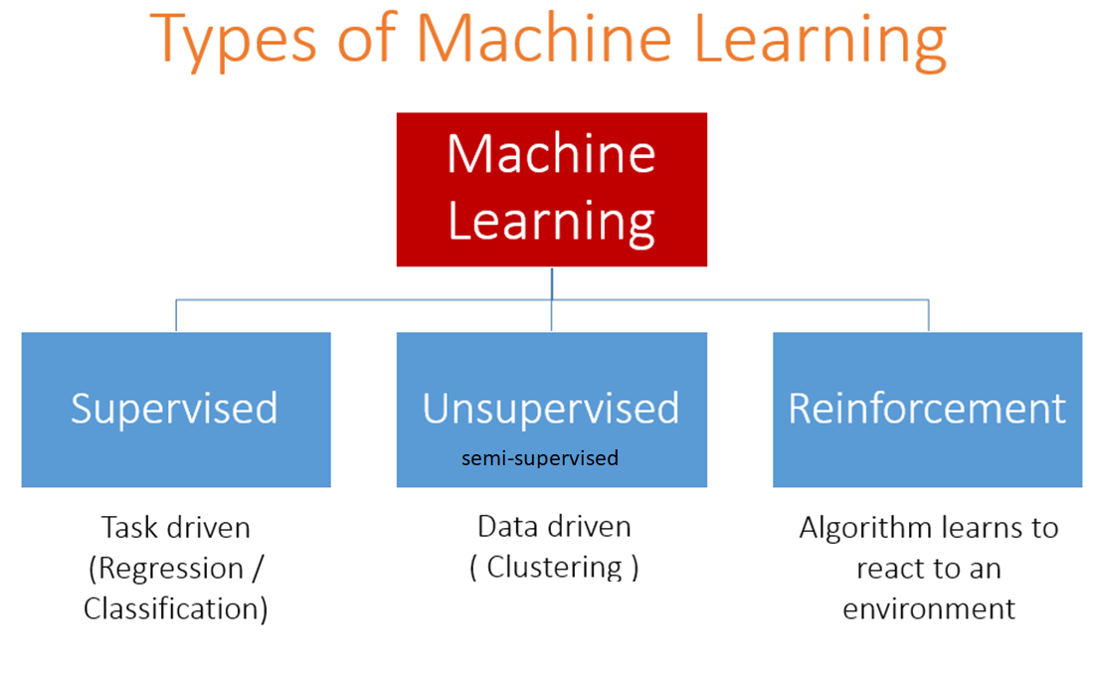

Slide 25
Key ML Terminology
Labels
A label is the thing we're predicting.
Features
A feature is an input variable
Examples or samples
An example is a particular instance of data, x.
labeled examples. A labeled example includes both feature(s) and the label.
unlabeled examples. An unlabeled example contains features but not the label.
Models
A model defines the relationship between features and label.
Training means creating or learning the model.
Inference means applying the trained model to unlabeled examples.

Slide 26
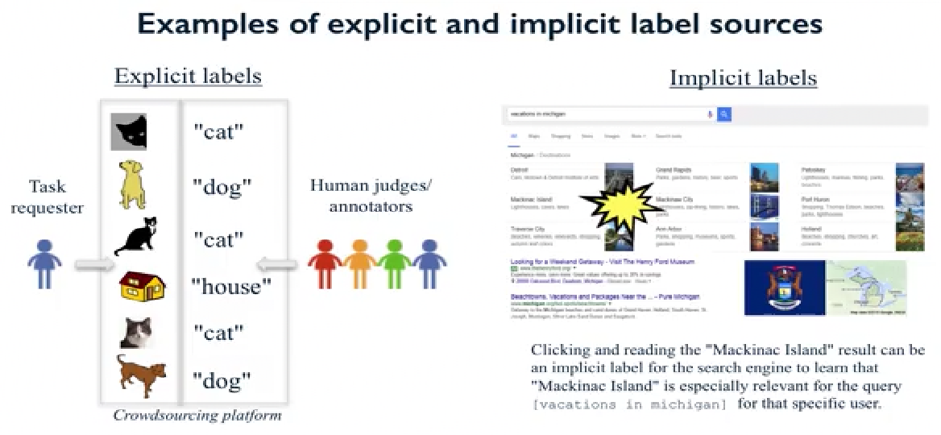

Slide 27
Key types of Machine Learning problems
Supervised machine learning: Learn to predict target values from labelled data/
Classification (target values are discrete classes)
Regression (target values are continuous values)
Unsupervised machine learining: Find structure in unlabeled data
Find groups of similar instances in the data (clusterin)
Finding unusual patterns (outlier detection)

Slide 28
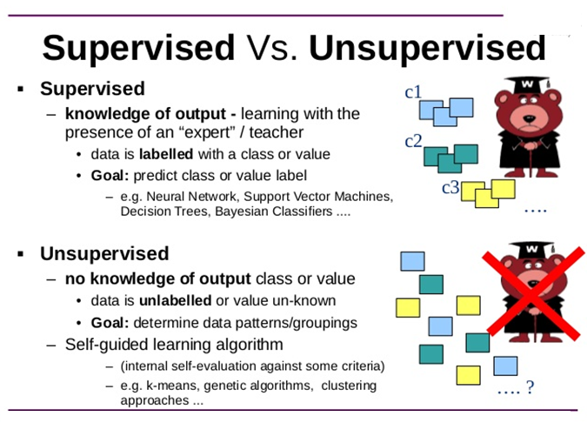

Slide 29
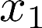
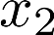
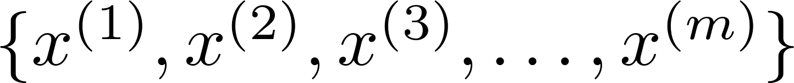
Supervised learning Unsupervised learning
Training set: Training set:

Slide 30
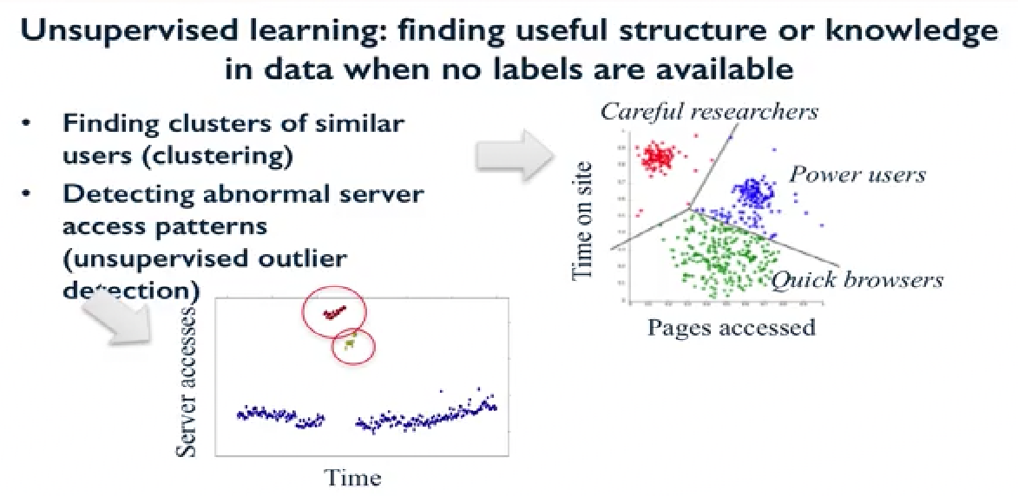

Slide 31
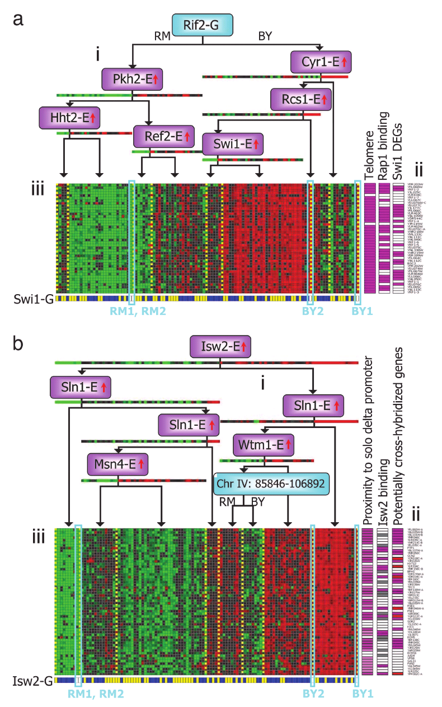
Genes
Individuals
[Source: Su-In Lee, Dana Pe’er, Aimee Dudley, George Church, Daphne Koller]

Slide 32



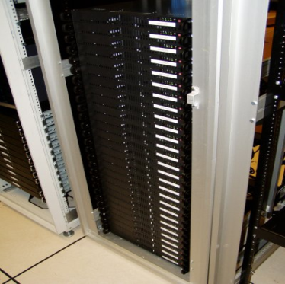
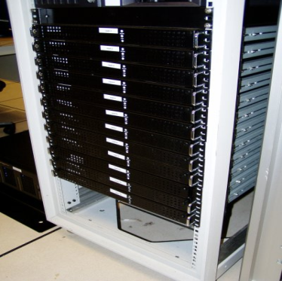
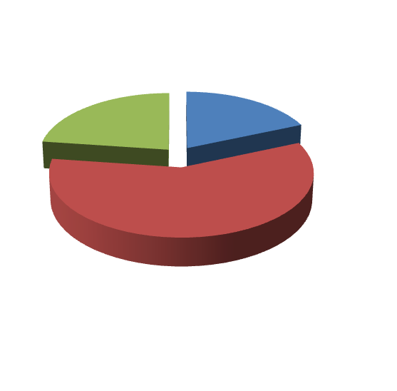
Applications of clustering
Market segmentation
Social network analysis
Image credit: NASA/JPL-Caltech/E. Churchwell (Univ. of Wisconsin, Madison)
Organize computing clusters
Astronomical data analysis
Notes:
Swap: market seg and organize clusters

Slide 33
Supervised or Unsupervised?
Examine the statistics of two football teams, and predicting which team will win tomorrow's match (given historical data of teams' wins/losses to learn from).
This can be addressed using supervised learning, in which we learn from historical records to make win/loss predictions.

Slide 34
Supervised or Unsupervised?
In farming, given data on crop yields over the last 50 years, learn to predict next year's crop yields.
This can be addresses as a supervised learning problem, where we learn from historical data (labeled with historical crop yields) to predict future crop yields.

Slide 35
Supervised or Unsupervised?
Take a collection of 1000 essays written on the Azerbaijan Economy, and find a way to automatically group these essays into a small number of groups of essays that are somehow "similar" or "related".
This is an unsupervised learning/clustering problem.

Slide 36
Supervised or Unsupervised?
Given data on how 1000 medical patients respond to an experimental drug (such as effectiveness of the treatment, side effects, etc.), discover whether there are different categories or "types" of patients in terms of how they respond to the drug, and if so what these categories are.
This can be addressed using an unsupervised learning, clustering, algorithm, in which we group the 1000 patients into different clusters based on their responses to the drug

Slide 37
Supervised or Unsupervised?
Given 50 articles written by male authors, and 50 articles written by female authors, learn to predict the gender of a new manuscript's author (when the identity of this author is unknown).
This can be addressed as a supervised learning, classification, problem, where we learn from the labeled data to predict gender.

Slide 38
Supervised or Unsupervised?
Given a large dataset of medical records from patients suffering from heart disease, try to learn whether there might be different clusters of such patients for which we might tailor separate treatments.
This can be addressed using an unsupervised learning, clustering, algorithm, in which we group patients into different clusters.

Slide 39
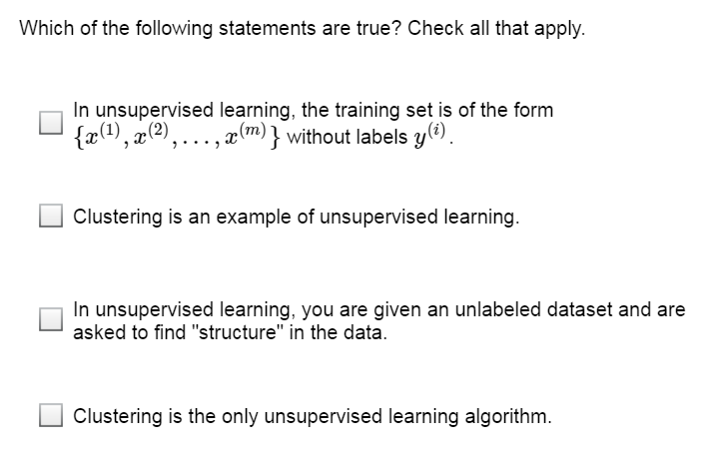

Slide 40
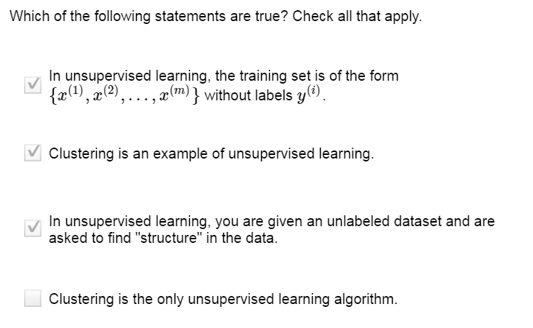

Slide 41
Key types of Machine Learning problems
Supervised machine learning: Learn to predict target values from labelled data/
Classification (target values are discrete classes)
Regression (target values are continuous values)
Unsupervised machine learining: Find structure in unlabeled data
Find groups of similar instances in the data (clusterin)
Finding unusual patterns (outlier detection)

Slide 42
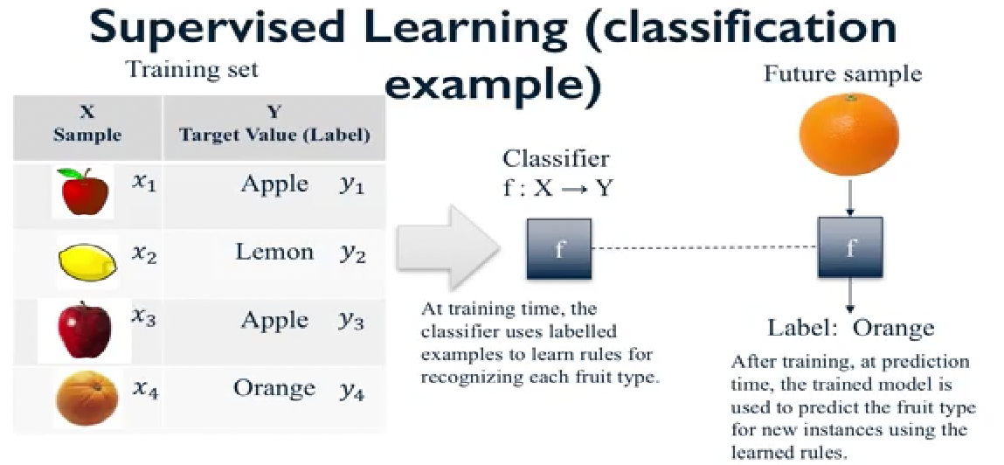

Slide 44
Housing price prediction.
Price ($)
in 1000’s
Size in feet²
Supervised Learning
“right answers” given
Regression: Predict continuous valued output (price)

Slide 45
Classification or Regression?
The amount of rain that falls in a day is usually measured in either millimeters (mm) or inches. Suppose you use a learning algorithm to predict how much rain will fall tomorrow. Would you treat this as a classification or a regression problem?
Regression is appropriate when we are trying to predict a continuous-valued output, such as the amount of rainfall measured in inches or mm.

Slide 46
Classification or Regression?
Suppose you are working on stock market prediction, Typically tens of millions of shares of Microsoft stock are traded (i.e., bought/sold) each day. You would like to predict the number of Microsoft shares that will be traded tomorrow. Would you treat this as a classification or a regression problem?
Classification is appropriate when we are trying to predict one of a small number of discrete-valued outputs. Even though the number of shares traded is technically discrete-valued (i.e., an integer), it would be more natural to treat it as a continuous value
Regression is appropriate when we are trying to predict a continuous-valued output, since as the price of a stock (similar to the housing prices example in the lectures).

Slide 47
Classification or Regression?
Suppose you are working on weather prediction, and your weather station makes one of three predictions for each day's weather: Sunny, Cloudy or Rainy. You'd like to use a learning algorithm to predict tomorrow's weather. Would you treat this as a classification or a regression problem?
Classification is appropriate when we are trying to predict one of a small number of discrete-valued outputs, such as whether it is Sunny (which we might designate as class 0), Cloudy (say class 1) or Rainy (class 2).

